Slide 1

CSC 533: Privacy in the Digital Age (Fall 2020) Lecture 6: Differential Privacy
Anupam Das
Aug 27, 2020

Slide 2
Goals for today
Techniques for achieving differential privacy
Pros and cons of differential privacy
Some contents are borrowed from online material provided by Li Xiong, Ashwin Machanavajjhala, Aaron Roth

Slide 3
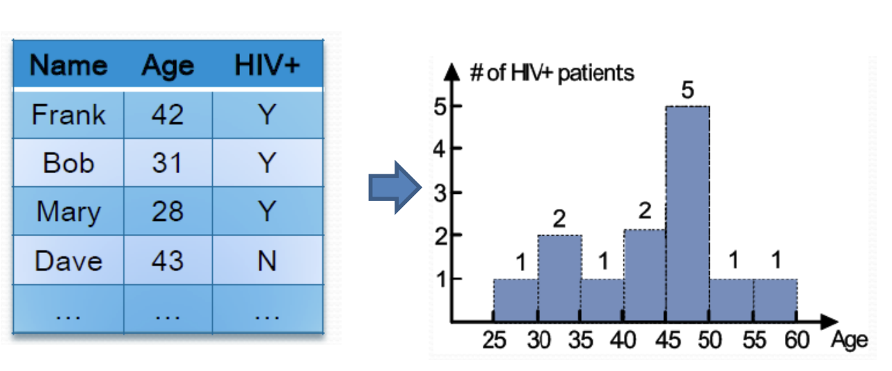
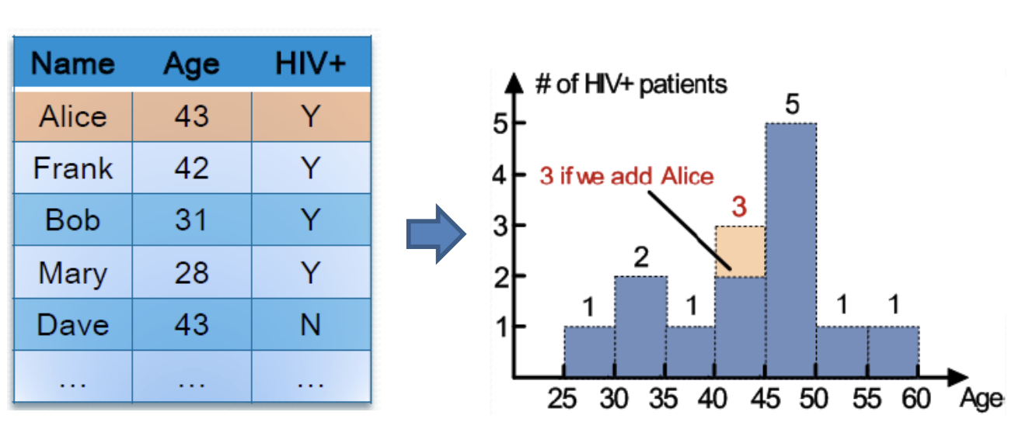
Motivations for differential privacy
Looking at the new histogram easy to determine Alice has HIV+

Slide 4


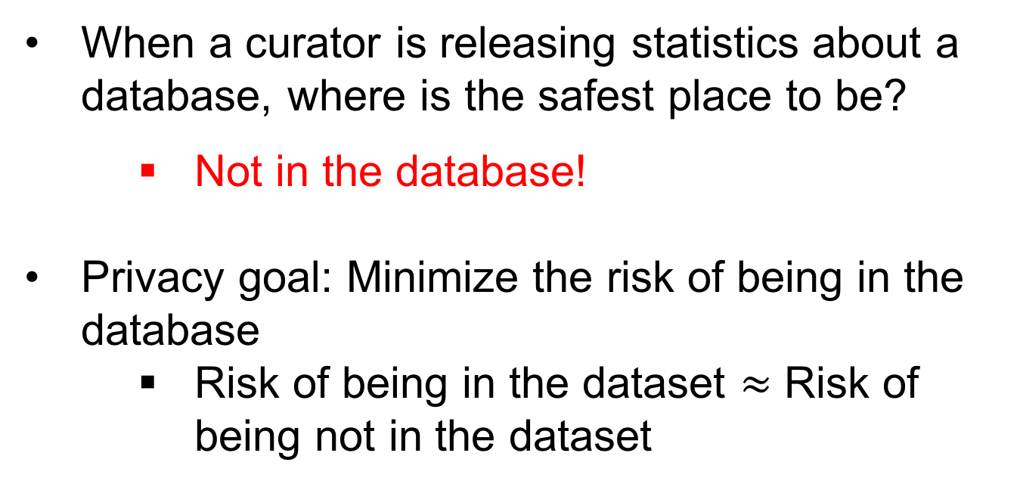
Towards a better privacy goal
When a curator is releasing statistics about a database, where is the safest place to be?
Not in the database!
Privacy goal: Minimize the risk of being in the database
Risk of being in the dataset $≈$ Risk of being not in the dataset
Plausible deniability of being in the dataset!

Slide 5
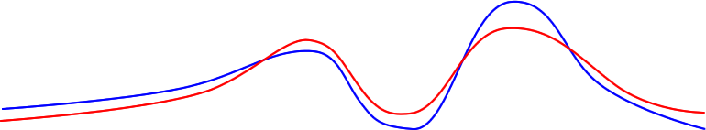


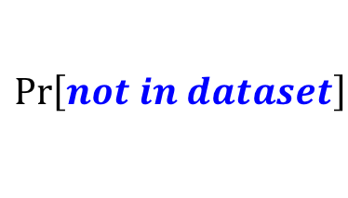
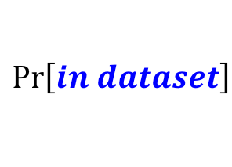
Differential privacy: Informally
D
D’
Curator’s output on D is very similar to Curator’s output on D’
Receiver can’t tell if a user is in the database or not
$$\operatorname{Pr}\left[in dataset\right]$$
Curator
Curator
difference
$$\operatorname{Pr}\left[not in dataset\right]$$
$$O$$
Output
$$≈$$
Output’

Slide 6
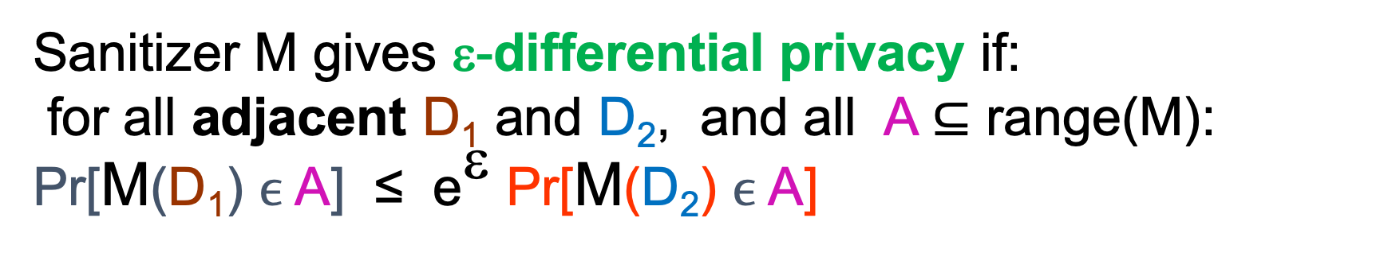
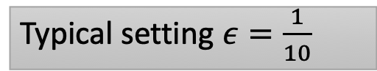
Differential Privacy: Formal definition
Sanitizer M gives ε-differential privacy if:
for all adjacent D₁ and D₂, and all A $⊆$ range(M):
Pr[M(D₁) $ϵ$ A] ≤ e^{ε} Pr[M(D₂) $ϵ$ A]
Participation in the data set poses no additional risk
Adversary does not distinguish whether I supplied real or fake input
ratio bounded
Pr [response]
Bad Responses:
Z
Z
Z
Typical setting $ε=\frac{1}{10}$

Slide 7

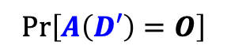
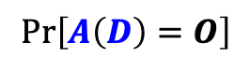
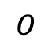
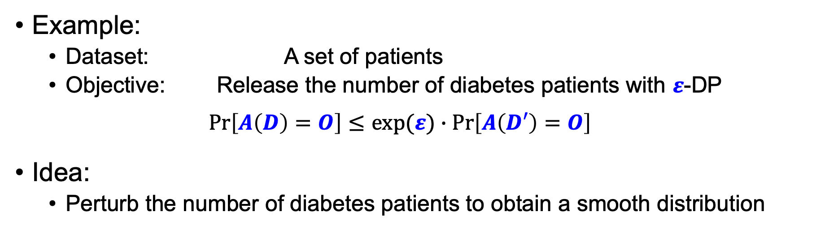
Achieving $ε$-differential privacy: setting
Example:
Dataset: A set of patients
Objective: Release the number of diabetes patients with $ε$-DP
$$\operatorname{Pr}\left[A\left(D\right)=O\right]≤exp(ε)∙\operatorname{Pr}\left[A\left(D′\right)=O\right]$$
Idea:
Perturb the number of diabetes patients to obtain a smooth distribution
ratio bounded
Prob.
$$\operatorname{Pr}\left[A\left(D\right)=O\right]$$
$$\operatorname{Pr}\left[A\left(D′\right)=O\right]$$
$$O$$
# of diabetes patients

Slide 8
Techniques for achieving DP
Output perturbation
Exponential mechanism
Input perturbation

Slide 9
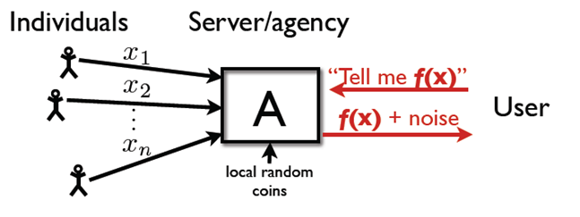
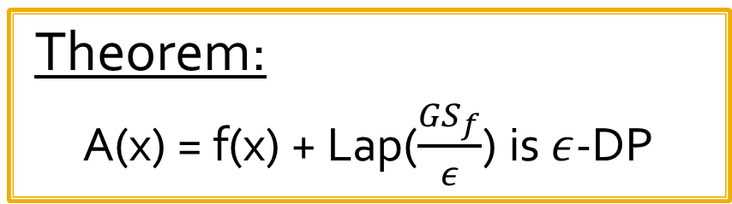
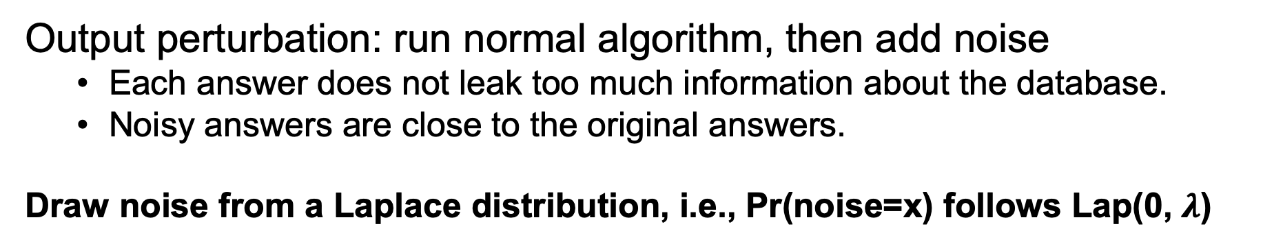
Output perturbation
Output perturbation: run normal algorithm, then add noise
Each answer does not leak too much information about the database.
Noisy answers are close to the original answers.
Draw noise from a Laplace distribution, i.e., Pr(noise=x) follows Lap(0, $λ$)

Slide 10
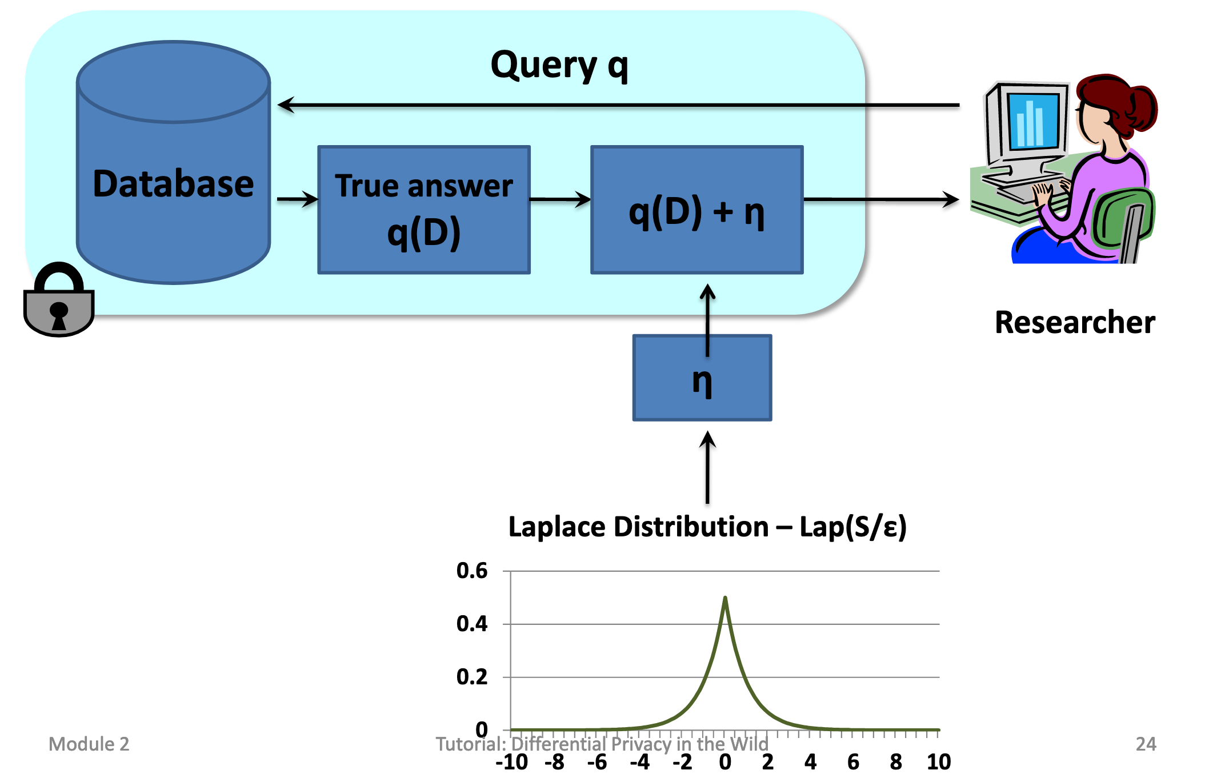
Illustrating output perturbation

Slide 11
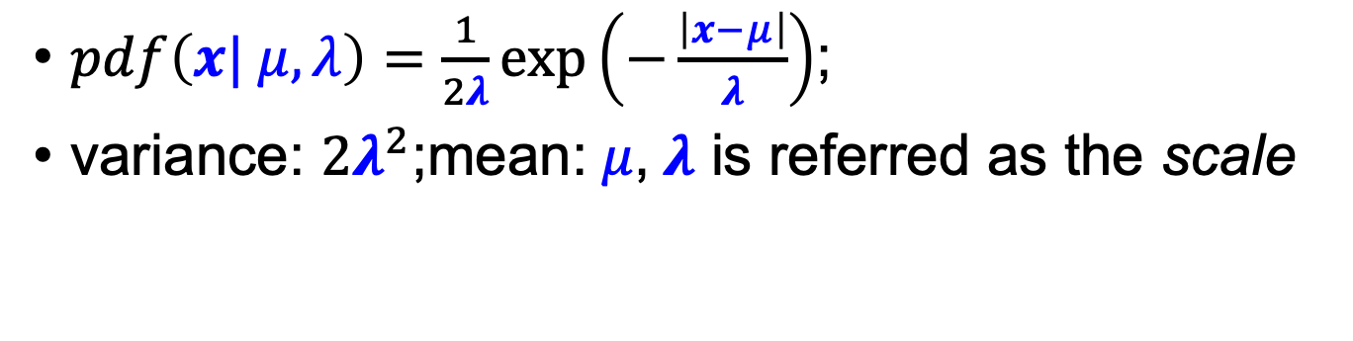
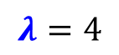
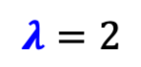

Laplace distribution
$pdf\left(x| μ,λ\right)=\frac{1}{2λ}exp\left(−\frac{\left|x−μ\right|}{λ}\right)$;
$\text{variance}\text{: }2λ^{2}$;mean:$μ$,$λ$ is referred as the scale
$$λ=1$$
$$λ=2$$
$$λ=4$$

Slide 12
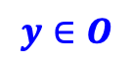
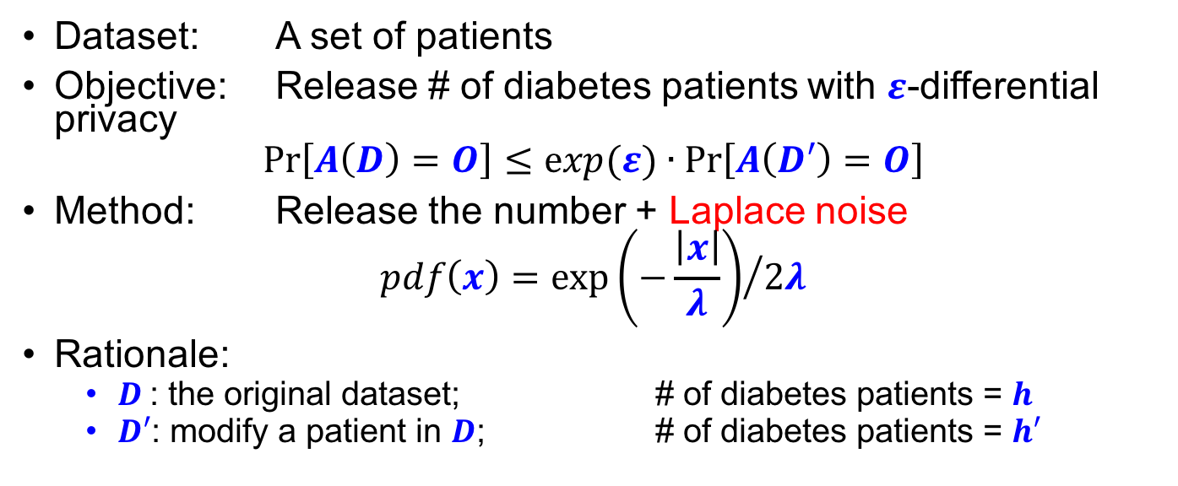
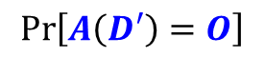
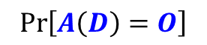
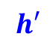
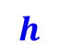
Differential Privacy via Laplace noise
Dataset: A set of patients
Objective: Release # of diabetes patients with $ε$-differential privacy
$$\operatorname{Pr}\left[A\left(D\right)=O\right]≤exp(ε)∙\operatorname{Pr}\left[A\left(D′\right)=O\right]$$
Method: Release the number + Laplace noise
$$pdf\left(x\right)={exp\left(−\frac{\left|x\right|}{λ}\right)}/{2λ}$$
Rationale:
$D$: the original dataset; # of diabetes patients = $h$
$D′$: modify a patient in $D$; # of diabetes patients = $h′$
ratio bounded
$$\operatorname{Pr}\left[A\left(D\right)=O\right]$$
$$\operatorname{Pr}\left[A\left(D′\right)=O\right]$$
$$h$$
$$h′$$
# of diabetes patients
$$y∈O$$

Slide 13
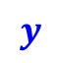
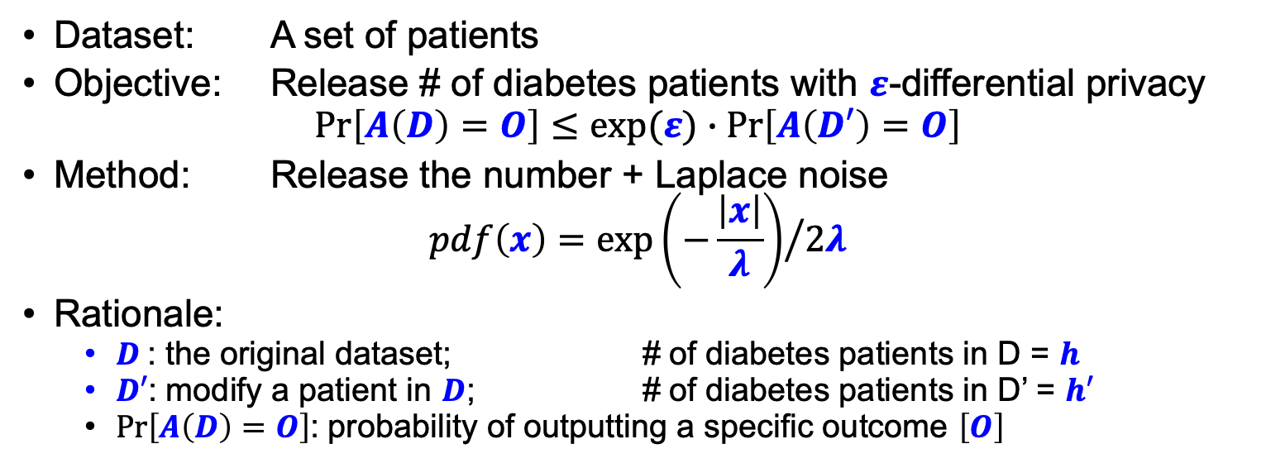
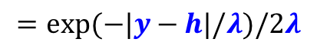
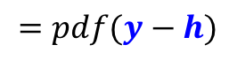
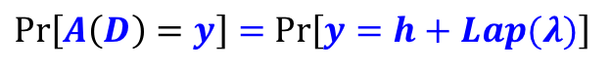
Differential Privacy via Laplace noise
Dataset: A set of patients
Objective: Release # of diabetes patients with $ε$-differential privacy
$$\operatorname{Pr}\left[A\left(D\right)=O\right]≤exp(ε)∙\operatorname{Pr}\left[A\left(D′\right)=O\right]$$
Method: Release the number + Laplace noise
$$pdf\left(x\right)={exp\left(−\frac{\left|x\right|}{λ}\right)}/{2λ}$$
Rationale:
$D$: the original dataset; # of diabetes patients in D = $h$
$D′$: modify a patient in $D$; # of diabetes patients in D’ = $h′$
$\operatorname{Pr}\left[A\left(D\right)=O\right]$: probability of outputting a specific outcome $\left[O\right]$
$\operatorname{Pr}\left[A\left(D\right)=y\right]=$ $\operatorname{Pr}\left[y=h+Lap(λ)\right]$
$$=pdf(y−h)$$
$$=exp(−|y−h|/λ)/2λ$$
shifted Laplace distribution
$$\operatorname{Pr}\left[A\left(D\right)=O\right]$$
Noise = y-h
$$h$$
$$y$$
# of diabetes patients

Slide 14
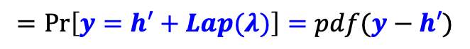
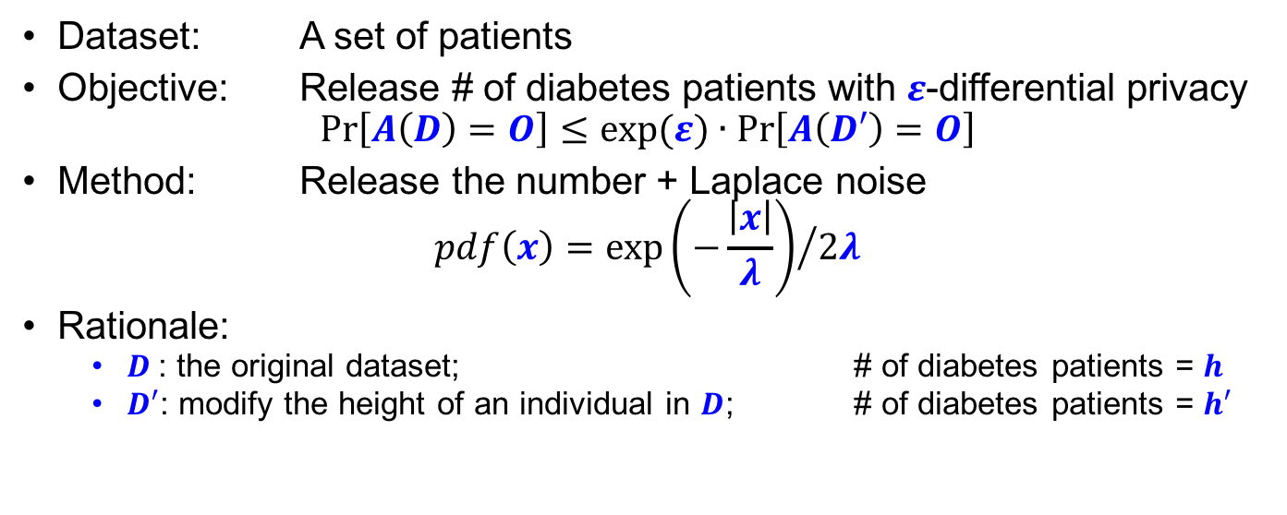
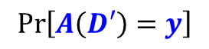
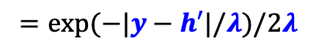
Differential Privacy via Laplace Noise
Dataset: A set of patients
Objective: Release # of diabetes patients with $ε$-differential privacy
$$\operatorname{Pr}\left[A\left(D\right)=O\right]≤exp(ε)∙\operatorname{Pr}\left[A\left(D′\right)=O\right]$$
Method: Release the number + Laplace noise
$$pdf\left(x\right)={exp\left(−\frac{\left|x\right|}{λ}\right)}/{2λ}$$
Rationale:
$D$: the original dataset; # of diabetes patients = $h$
$D′$: modify the height of an individual in $D$; # of diabetes patients = $h′$
$$\operatorname{Pr}\left[A\left(D′\right)=y\right]$$
$$=\operatorname{Pr}\left[y=h′+Lap(λ)\right]=pdf(y−h′)$$
$$=exp(−|y−h′|/λ)/2λ$$
$$\operatorname{Pr}\left[A\left(D′\right)=O\right]$$
$$y$$
$$h′$$
# of diabetes patients

Slide 15
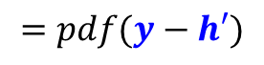
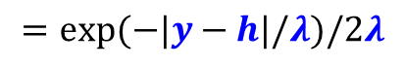
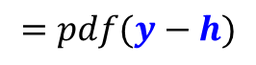
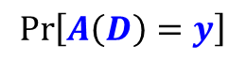
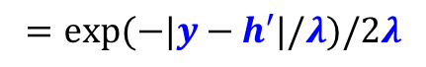
Differential Privacy via Laplace Noise
Dataset: A set of patients
Objective: Release # of diabetes patients with $ε$-differential privacy
$$\operatorname{Pr}\left[A\left(D\right)=O\right]≤exp(ε)∙\operatorname{Pr}\left[A\left(D′\right)=O\right]$$
Method: Release the number + Laplace noise
$$pdf\left(x\right)={exp\left(−\frac{\left|x\right|}{λ}\right)}/{2λ}$$
Rationale:
$D$: the original dataset; # of diabetes patients = $h$
$D′$: modify the height of an individual in $D$; # of diabetes patients = $h′$
$$\operatorname{Pr}\left[A\left(D′\right)=y\right]$$
$$=pdf(y−h′)$$
$$=exp(−|y−h′|/λ)/2λ$$
$$\operatorname{Pr}\left[A\left(D\right)=y\right]$$
$$=pdf(y−h)$$
$$=exp(−|y−h|/λ)/2λ$$
$$\operatorname{Pr}\left[A\left(D\right)=O\right]$$
$$\operatorname{Pr}\left[A\left(D′\right)=O\right]$$
$$h$$
$$y$$
$$h′$$
# of diabetes patients

Slide 16

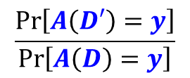
Differential Privacy via Laplace Noise
Dataset: A set of patients
Objective: Release # of diabetes patients with $ε$-differential privacy
$$\operatorname{Pr}\left[A\left(D\right)=O\right]≤exp(ε)∙\operatorname{Pr}\left[A\left(D′\right)=O\right]$$
Method: Release the number + Laplace noise
$$pdf\left(x\right)={exp\left(−\frac{\left|x\right|}{λ}\right)}/{2λ}$$
Rationale:
$D$: the original dataset; # of diabetes patients = $h$
$D′$: modify the height of an individual in $D$; # of diabetes patients = $h′$
$$\frac{\operatorname{Pr}\left[A\left(D′\right)=y\right]}{\operatorname{Pr}\left[A\left(D\right)=y\right]}$$
$$=pdf(y−h′)$$
$$=exp(−|y−h′|/λ)/2λ$$
$$=pdf(y−h)$$
$$=exp(−|y−h|/λ)/2λ$$
$$\operatorname{Pr}\left[A\left(D\right)=O\right]$$
$$\operatorname{Pr}\left[A\left(D′\right)=O\right]$$
""
$$h$$
$$y$$
$$h′$$
# of diabetes patients

Slide 17
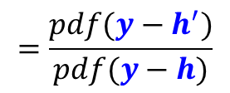
Differential Privacy via Laplace Noise
Dataset: A set of patients
Objective: Release # of diabetes patients with $ε$-differential privacy
$$\operatorname{Pr}\left[A\left(D\right)=O\right]≤exp(ε)∙\operatorname{Pr}\left[A\left(D′\right)=O\right]$$
Method: Release the number + Laplace noise
$$pdf\left(x\right)={exp\left(−\frac{\left|x\right|}{λ}\right)}/{2λ}$$
Rationale:
$D$: the original dataset; # of diabetes patients = $h$
$D′$: modify the height of an individual in $D$; # of diabetes patients = $h′$
$$\frac{\operatorname{Pr}\left[A\left(D′\right)=y\right]}{\operatorname{Pr}\left[A\left(D\right)=y\right]}$$
$$=\frac{pdf(y−h^{′})}{pdf(y−h)}$$
$$=exp(−|y−h′|/λ)/2λ$$
$$=exp(−|y−h|/λ)/2λ$$
$$\operatorname{Pr}\left[A\left(D\right)=O\right]$$
$$\operatorname{Pr}\left[A\left(D′\right)=O\right]$$
$$h$$
$$y$$
$$h′$$
# of diabetes patients

Slide 18
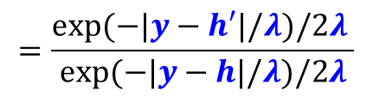
Differential Privacy via Laplace Noise
Dataset: A set of patients
Objective: Release # of diabetes patients with $ε$-differential privacy
$$\operatorname{Pr}\left[A\left(D\right)=O\right]≤exp(ε)∙\operatorname{Pr}\left[A\left(D′\right)=O\right]$$
Method: Release the number + Laplace noise
$$pdf\left(x\right)={exp\left(−\frac{\left|x\right|}{λ}\right)}/{2λ}$$
Rationale:
$D$: the original dataset; # of diabetes patients = $h$
$D′$: modify the height of an individual in $D$; # of diabetes patients = $h′$
$$\frac{\operatorname{Pr}\left[A\left(D′\right)=y\right]}{\operatorname{Pr}\left[A\left(D\right)=y\right]}$$
$$=\frac{pdf(y−h^{′})}{pdf(y−h)}$$
$$=\frac{exp(−|y−h′|/λ)/2λ }{exp(−|y−h|/λ)/2λ}$$
$$\operatorname{Pr}\left[A\left(D\right)=O\right]$$
$$\operatorname{Pr}\left[A\left(D′\right)=O\right]$$
$$h$$
$$y$$
$$h′$$
# of diabetes patients

Slide 19
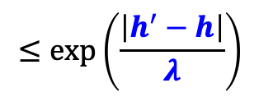
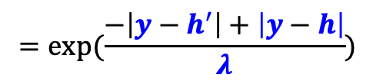
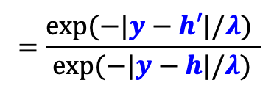
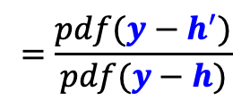
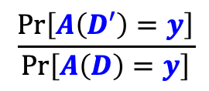
Differential Privacy via Laplace Noise
Dataset: A set of patients
Objective: Release # of diabetes patients with $ε$-differential privacy
$$\operatorname{Pr}\left[A\left(D\right)=O\right]≤exp(ε)∙\operatorname{Pr}\left[A\left(D′\right)=O\right]$$
Method: Release the number + Laplace noise
$$pdf\left(x\right)={exp\left(−\frac{\left|x\right|}{λ}\right)}/{2λ}$$
Rationale:
$D$: the original dataset; # of diabetes patients = $h$
$D′$: modify the height of an individual in $D$; # of diabetes patients = $h′$
Using, |a| – |b| <= |a – b|
Triangle Inequality
$$\frac{\operatorname{Pr}\left[A\left(D′\right)=y\right]}{\operatorname{Pr}\left[A\left(D\right)=y\right]}$$
$$=\frac{pdf(y−h^{′})}{pdf(y−h)}$$
$$=\frac{exp(−|y−h′|/λ) }{exp(−|y−h|/λ)}$$
$$=exp(\frac{−\left|y−h^{′}\right|+\left|y−h\right|}{λ})$$
$$≤\exp\left(\frac{\left|h^{′}−h\right|}{λ}\right)$$
$$\operatorname{Pr}\left[A\left(D\right)=O\right]$$
$$\operatorname{Pr}\left[A\left(D′\right)=O\right]$$
$$h$$
$$y$$
$$h′$$
# of diabetes patients

Slide 20
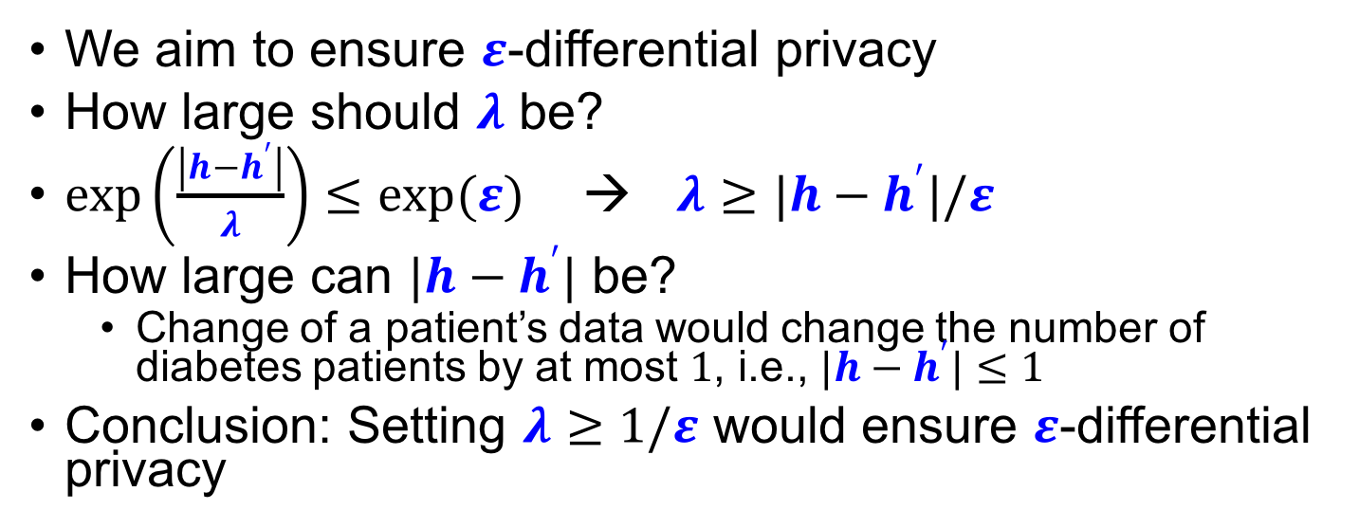
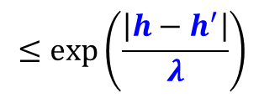
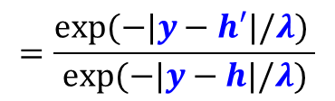
Differential Privacy via Laplace Noise
We aim to ensure $ε$-differential privacy
How large should $λ$ be?
$\exp\left(\frac{\left|h−h^{′}\right|}{λ}\right)≤exp(ε)$ → $λ≥|h−h^{′}|/ε$
How large can $|h−h^{′}|$ be?
Change of a patient’s data would change the number of diabetes patients by at most $1$, i.e., $|h−h^{′}|≤1$
Conclusion: Setting $λ≥1/ε$ would ensure $ε$-differential privacy
$$\frac{\operatorname{Pr}\left[A\left(D′\right)=y\right]}{\operatorname{Pr}\left[A\left(D\right)=y\right]}$$
$$=\frac{pdf(y−h^{′})}{pdf(y−h)}$$
$$=\frac{exp(−|y−h′|/λ) }{exp(−|y−h|/λ)}$$
$$≤\exp\left(\frac{\left|h−h^{′}\right|}{λ}\right)$$
$$\operatorname{Pr}\left[A\left(D\right)=O\right]$$
$$\operatorname{Pr}\left[A\left(D′\right)=O\right]$$
$$h$$
$$y$$
$$h′$$
# of diabetes patients

Slide 21


Global sensitivity
In general, if we want to release a value $v$
Add Laplace noise into $v$
To decide the scale $λ$of Laplace noise
Look at the maixmum change that can occur in $v$ (when we change one tuple in the dataset)
Set $λ$ to be proportional to the maximum change
$λ$ = sensitivity/ $ε$

Slide 22

Utility of Laplace mechanism
Laplace mechanism works for any function that returns a real number
Variance in utility :
E(true answer – noisy answer)²
= Var( Lap(S(q)/ε) ) = 2*S(q)² / ε ²
Std. dev = O(S(q)/ε)
$$V\text{ariance} \text{for} \text{Lap}\text{(0,}λ\text{)}\text{: }2λ^{2}$$

Slide 23




Impact of ε
$$λ=1$$
$$λ=2$$
$$λ=4$$
$λ$ = sensitivity/ $ε$
What can we say about the end user’s privacy when ε has the following values?
ε = 0.00; perfect privacy,
ε = 0.01; the 2 probabilities differ by at most 1%
ε = 0.10; the 2 probabilities differ by at most 10%
ε = 1.0; the 2 probabilities differ by less than a factor of 3 (e is approx. 2.71)
ε = 10.00; little privacy!

Slide 24

Sequential composition
What happens if we ask multiple questions about same data?
We reveal more, so the bound on $ε$ differential privacy weakens
Suppose we output via K1 and K2 with $ε$1, $ε$2 differential privacy:
Pr[ K1(D) = S1 ] $≤$ exp($ε$1) Pr[K1(D’) = S1], and Pr[ K2(D) = S2 ] $≤$ exp($ε$2) Pr[K2(D’) = S2]
Pr[ (K1(D) = S1), (K2(D) = S2)] = Pr[K1(D)=S1] * Pr[K2(D) = S2] $≤$ exp($ε$1) Pr[K1(D’) = S1] * exp($ε$2) Pr[K2(D’) = S2]
= exp($ε$1 + $ε$2) Pr[(K1(D’) = S1), (K2(D’) = S2)]
Use the fact that the noise distributions are independent
Bottom line: result is $ε$1 + $ε$2 differentially private – Can reason about sequential composition by just “adding the $ε$’s”

Slide 25
Answering 𝑘 queries: Privacy budget
Answer 𝑘 queries, each with sensitivity 1 • Use Laplace with 𝜀₀ = 𝜀/𝑘 privacy per query
Better privacy, more noise per query (∼ Lap 𝑘/𝜀 )
Composition: 𝜀-privacy for all 𝑘 answers

Slide 26

Parallel composition
Sequential composition is pessimistic
Assumes outputs are correlated, so budget gets consumed fast
If the query touches disjoint parts of the date base then all you need is max($ε$₁, …, $ε$_{n})
Example:
Ask for count of people broken down by handedness and hair color
Each cell is a disjoint set of individuals
Can release each cell with $ε−$differential privacy (parallel composition) instead of 6$ε$ DP (sequential composition)
 | Red hair | Blond | Brunette
Left-handed | 23 | 35 | 56
Right-handed | 215 | 360 | 493

Slide 27
Exponential mechanism
What happens when we want to output non-numeric values?
Exponential mechanism is most general approach
– Captures all possible DP mechanisms
– But ranges over all possible outputs, may not be efficient
Requirements:
Input value D
Set of possible outputs R
Quality function, q, assigns “score” to possible outputs r
q(D, r) should mirror the true answer as much as possible.
Sensitivity of Δ = S(q) = max_{x,x’,r} |q(D,r) – q(D’,r)|

Slide 28

Example: Exponential Mechanism
Scoring/utility function q: Inputs x Outputs → R
D: nationalities of a set of people
A: most common nationality
q (D, r) = #(D, r) the number of people with nationality r $∈$O
Pr[ A(D)=r ] ∝ exp(q(D, r)) for some nationality r $∈$O
Now compute the differentially private answer for all nationality and output the one with highest number

Slide 29



Exponential Mechanism
Theorem: For a database D, output space R and a utility score function q : D×R → R, the algorithm A
Pr[A(D) = r] ∝ exp (ε × q(D, r)/ 2Δ)
satisfies ε-differential privacy, where Δ is the sensitivity of the utility score function,
Δ = GS(q) = max _{𝑟∈𝑅,𝐷,𝐷′: ||𝐷−𝐷′ ||≤1} |q(D, r) - q(D’, r)|
$λ$ = 2* Δ / ε
Idea: make high quality outputs exponentially more likely at a rate that depends on the sensitivity of the quality score (and the privacy parameter)

Slide 30

Formal proof
Fix any 𝐷, 𝐷′ ∈ N^{|𝑋|} with ||𝐷, 𝐷′ || ₁ ≤ 1 and any 𝑟 ∈ 𝑅...

Slide 31

Formal proof
Note:
|q(D, r) - q(D’, r)|<= Δ where
Δ = max _{𝑟∈𝑅,𝐷,𝐷′: 𝐷−𝐷′ 1≤1} |q(D, r) - q(D’, r)|

Slide 32

Formal proof
Note:
|q(D, r) - q(D’, r)|<= Δ
➔ -Δ <=q(D, r) - q(D’, r) <= Δ
➔ q(D’, r)<= q(D, r) + Δ

Slide 33

Formal proof

Slide 34



Randomized Response
Original DB
D
D’
Consider 2 databases D, D’ (of size M) that differ in the j-th value only
– D[j] ≠ D’[j]. But, D[i] = D’[i], for all i ≠ j
– Only one users response is different
Has Disease
Y
N
Y
N
N
[jth]
N
Y
Has Disease
Y
N
Y
N
N
[Y]
N
Y
Has Disease
Y
N
Y
N
N
[N]
N
Y
Flip a coin
and answer
with ‘Y’ or ‘N’
Consider some output function O then
$\frac{Pr[D→O]}{Pr[D^{′}→O]}$ = $\frac{j−th user told the truth}{j−th the user lied }$ = $\frac{p}{1−p}$ <= $eε$
^{Or}
$\frac{Pr[D→O]}{Pr[D^{′}→O]}$ = $\frac{j−th the user lied}{j−th the user told the truth}$ = $\frac{1−p}{p}$ <= $eε$
Two versions possible
Simplifying these inequalities gives -
If p lies within this range we can ensure $ε$-differential privacy

Slide 35






Random response: utility
Flip a coin
If head ans. correctly
If tail lie
Yes
$\operatorname{Pr}\left(Observed Yes answers\right)=\frac{\#yes}{\#participants}$= $λ$
$$π$$
Ans.
truthfully
$$\operatorname{Pr}\left(True Yes answers\right)= π$$
No
p
$$1−π$$
Flip coin
Utility Analysis:
$$λ=pπ+\left(1−p\right)\left(1−π\right)$$
$π$= ($λ+p−1)/(2p−1)$
Compute $π$ from $λ$ obversation
Yes
$$1−π$$
1-p
Lie
$$π$$
No

Slide 36








Example: Random response
Question: “Have you engaged in drugs in the past week?”
1. Flip a coin. 2. If tails, then respond truthfully. 3. If heads, then flip a second coin and respond “Yes” if heads and “No” if tails.
$$\operatorname{Pr}\left[Response = Yes | Truth = Yes\right]$$
$$=\frac{\operatorname{Pr}\left[Response = Yes and Truth = Yes\right]}{\operatorname{Pr}{[Truth = Yes]}}$$
= $\frac{\# of people who responsed with{}_{}^{′}yes^{′}and also spoke the truth}{\# of people who spoke the{truth}}$
= (0.5* $π$ + 0.5*0.5* $π)$/ $π$ = 3/4
Say the truth (only $π$ portion actually used)
tails
Yes ($π$ portion actually has used)
Hint: When the coin lands tail $π$portion of the people say ‘Yes’ or when the first and second come up heads, $π$ portion of the people say ‘Yes’
head
head
$$\operatorname{Pr}\left[Response = Yes | Truth =No\right].$$
= 0.5* $0.5∗(1−π)$/ $(1−π)$ = 1/4
tails
No ($1−π$ portion actually hasn’t used)
=?
(ln 3)-differentially private because [e^{ln 3} = 3]

Slide 37
Laplace Mechanism vs Randomized Response
Privacy:
Provides the same ε-differential privacy guarantee
Laplace mechanism assumes data collector is trusted
Randomized Response does not require data collector to be trusted
Also called a Local Algorithm, since each record is perturbed
Utility:
Suppose a database with N records where μN records have disease = Y.
Query: # rows with Disease=Y
Std dev of Laplace mechanism answer: O(1/ε)
Std dev of Randomized Response answer: O(√N)

Slide 38
Pros and Cons
Pros
First formalization of privacy that is independent of background knowledge
Constructions are generally straightforward
Cons
“Privacy budget” gets consumed with multiple queries
If algorithms are ε-differentially private and issue q queries, then results are qε-differentially private
Need to add a lot of noise if query function has high sensitivity
Less effective when there exist correlations among the tuples
Amount of noise needed depends on the correlations among the tuples, which is not captured by the basic differential privacy approach

Slide 39

Impact of numerous queries
Overall, the mean is noisier with fewer queries (since the sample sizes are small). As expected, the confidence intervals become narrower as the adversary makes more queries (since the sample size increases, and the noise averages to zero). Just from inspecting the graph, we can see that it takes about 50 queries to make a decent estimate.
Source: https://medium.com/georgian-impact-blog/a-brief-introduction-to-differential-privacy-eacf8722283b

Slide 40

Exercise
Function f: # individuals with salary > $30K
Global Sensitivity of f = ?
Answer: 1
Function f: privacy preserving Histogram computation
Global Sensitivity of f = ?
Answer: 1
Sensitivity of the bin counts: 1
Scale of Laplace noise required: $1/ε$

Slide 41
Logistics
Project proposal due Aug 31 @ 11:59pm
Home Assignment 1 due Sept 4@11:59pm)

